Slide 1

Java 9 – New Features
Dima Ionut Daniel

Slide 2
Contents
What is Java?
History
Java Flavors
New Features
Module System
JSHell
New HTTP Client
Stack-Walking API
HTML 5 Javadoc
Unified JVM Logging
Reactive Streams
Other Improvements
Bibliography

Slide 3

What is Java?
Java is a programming language created by Sun Microsystems.
Java is used in a wide variety of computing platforms from embedded devices and mobile phones on the low end, to enterprise servers and supercomputers on the high end.
Memory management is handled through integrated automatic garbage collection performed by the JVM.

Slide 4
What is Java? (cont.)
The heart of the Java platform is the concept of a "virtual machine" that executes Java bytecode programs. This bytecode is the same no matter what hardware or operating system the program is running under.
There is a JIT(Just-In-Time) compiler within the Java Virtual Machine, or JVM. The JIT compiler translates the Java bytecode into native processor instructions at run-time and caches the native code in memory during execution.
The Java programs are cross-platform or platform independent, but the code of the Java Virtual Machines (JVM) that execute these programs is not.

Slide 5
History
The initial Java release was named Oak, and the first stable version was JDK 1.0.2, called Java 1.
JDK 1.0 - 23 January 1996
JDK 1.1 – 19 February 1997
J2SE 1.2 – 8 December 1998 (codename Playground)
J2SE 1.3 – 8 May 2000 (codename Kestrel)
J2SE 1.4 – 6 February 2002 (codename Merlin)
J2SE 5.0 – 30 September 2004 (codename Tiger)
Java SE 6 – 11 December 2006 (codename Mustang)
Java SE 7 – 7 July 2011(codename Dolphin)
Java SE 8 – 18 March 2014 (codename Spider)
Java SE 9 – planned for 2016

Slide 6
Java Flavors
The Java distribution comes in different flavors:
Java Card →run securely on smart cards and similar small-memory devices.
Java ME(Micro Edition) → Specifies several different sets of libraries (known as profiles) for devices with limited storage, display, and power capacities.
Java SE(Standard Edition) → for general-purpose use on desktop PCs, servers and similar devices.
Java EE(Enterprise Edition) → Java SE plus various APIs useful for multi-tier client–server enterprise applications.

Slide 7
New Features
Module System
JShell (Project Kulla)
New HTTP Client
Stack-Walking API
HTML 5 Javadoc

Slide 8
Module System
With Java 9 modules, we will be able to precisely define which parts of our code will be available for other modules.
A module is a JAR file, compiled from Java files, but there is one of the files is called module-info.java.
It defines:
the unique name of our module
which other modules our module depends on
which packages are to be exported to be used by other modules

Slide 9
Module System (cont.)
Automatic modules
Any JAR on the module path without module descriptor ends up as an automatic module, allowing your Java 9 project to use pre-Java-9 libraries
JDK will generate one depending on the JAR filename.
It will remove the file extension and the trailing version number (if any) and replace non-alphanumeric characters by dots.
Example: mongo-java-driver-3.3.0.jar will end up as module named mongo.java.driver.

Slide 10
Module System (cont.)
Unnamed module
All JARs (modular or not) and classes on the classpath will be contained in the Unnamed Module.
The unnamed module can access all other modules.

Slide 11
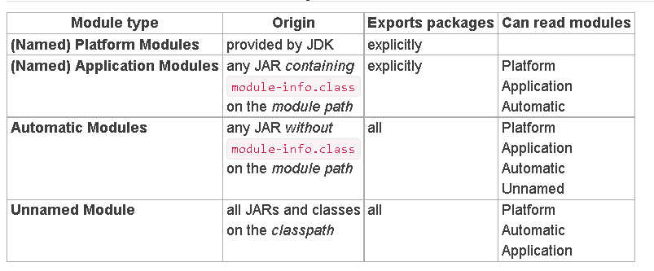
Module System (cont.)
Platform modules
JDK has been migrated into a modular structure.
ALl the basic Java features we use will be provided by different modules: java.xml, java.logging, java.httpclient, etc.

Slide 12
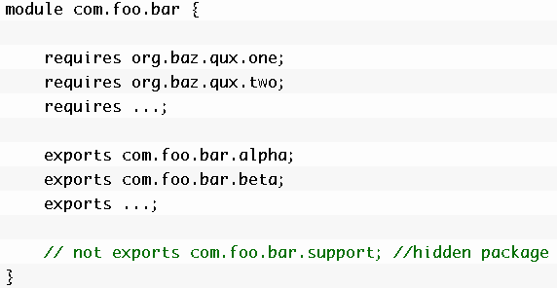
Module System (cont.)
Example of module-info.java file
module [module name] {…} defines name of a module.
requires + [module name] indicates the module that current module depends upon, at both compile time and run time.
exports + [package name] exports package to outside or to other modules. All other packages (which are not exported) are hidden.

Slide 13
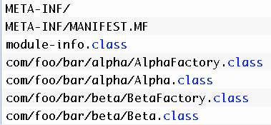
Module System (cont.)
Module Artifact
A module declaration is compiled into module-info.class, placed similarly in the class file output directory.
A modular JAR file is like an ordinary JAR file but also includes a module-info.class file.

Slide 14
Module System (cont.)
Modular JAR file allows to ship a single artifact that works:
as a module, on Java 9 and later
as a regular JAR file on the class path, on all releases.

Slide 15
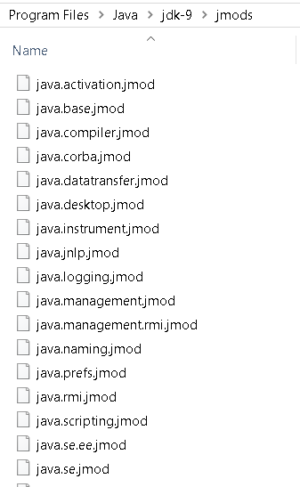
Module System (cont.)
A module artifact could be a modular JAR file or a JMOD file containing a compiled module definition.
We can find JMODs files in the JDK/jmods folder.

Slide 16
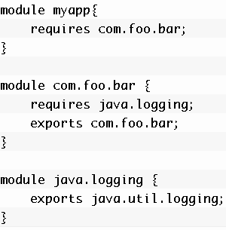
Module System (cont.)
Sample module declaration:
Code in myapp module can refer to types in com.foo.bar module.
Code in com.foo.bar module can refer to types in java.logging module.
As conclusion we can say that myapp reads com.foo.bar and com.foo.bar reads java.logging.

Slide 17
JShell
JShell is a Java read-eval-print loop tool.
It's tracked by JEP 222: The Java Shell (Read-Eval-Print Loop).
Java JShell was introduced in Java 9 as project Kulla.
It's great for education, investigating API that are unfamiliar to you, good for quick prototyping of tricky code.

Slide 18
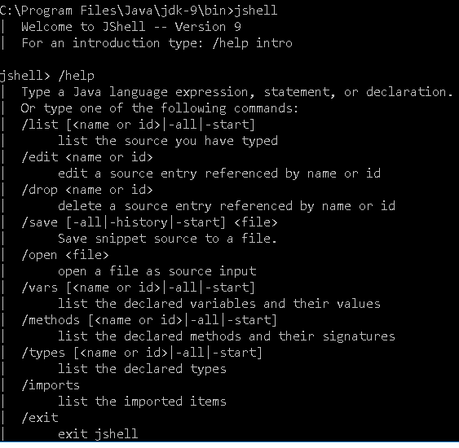
Jshell (cont.)

Slide 19
New HTTP Client
Java 1.9 comes with a brand new HTTP client and it not only brings support for HTTP/2, but has a comprehensive API.
HTTP 2 brings:
bidirectional communication using push requests
multiplexing within a single TCP connection
long running connections
stateful connections

Slide 20
New HTTP Client (cont.)
HTTP client will be delivered as an incubator module with JDK 9.
This has a few implications:
In JDK 9, the module is called jdk.incubator.httpclient.
This incubator module will be replaced by java.httpclient in JDK 10.
JDK 10 might bring breaking changes to the API.

Slide 21
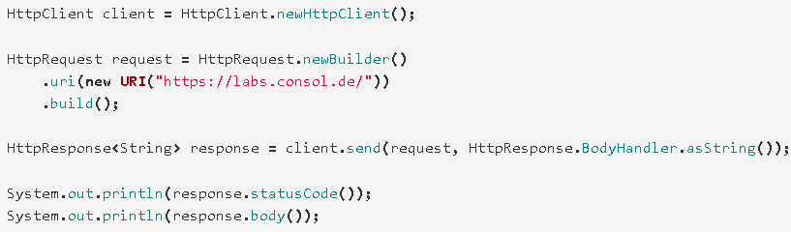
New HTTP Client (cont.)
There are 3 classes when we need to send HTTP requests: a HttpClient will be used to send HttpRequests and receive HttpResponse.

Slide 22
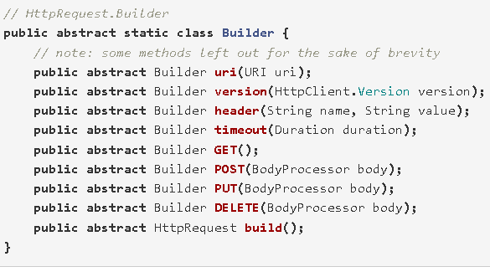
New HTTP Client (cont.)
We can obtain an instance of HttpRequest.Builder by calling HttpRequest.newBuilder().

Slide 23
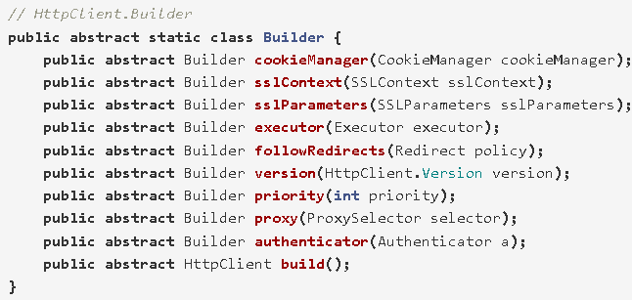
New HTTP Client (cont.)
With HttpRequest, we can use HttpClient.newBuilder() to obtain an instance of HttpClient.Builder.

Slide 24
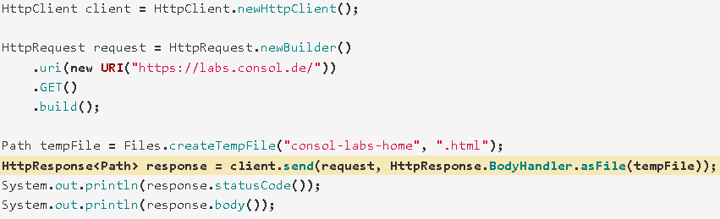
New HTTP Client (cont.)
We can save a downloaded file to local file system using HttpResponse.BodyHandler.asFile(Path).

Slide 25
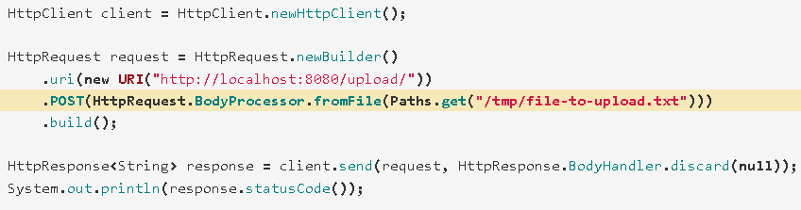
New HTTP Client (cont.)
We can upload a file from local system via POST using a HttpRequest.BodyProcessor..

Slide 26
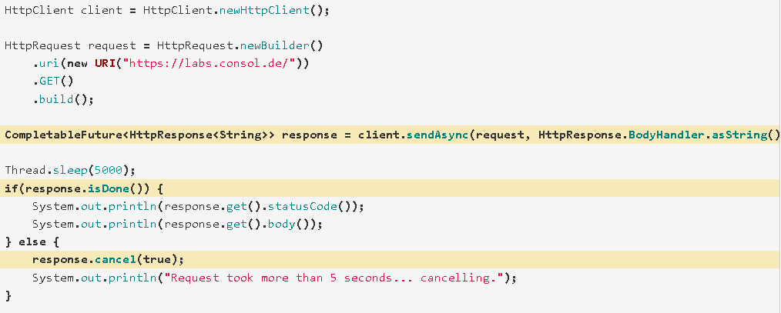
New HTTP Client (cont.)
We can use asynchronous HTTP calls using HttpClient.sendAsync().

Slide 27
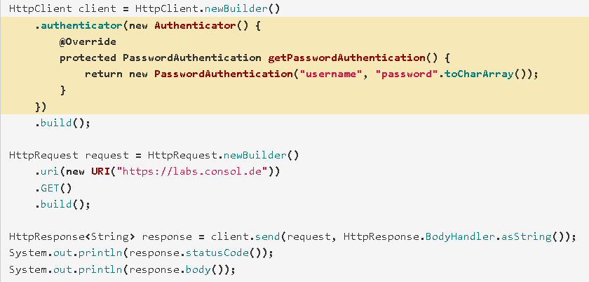
New HTTP Client (cont.)
In case we need basic authentication we can use the Authenticator.

Slide 28
Stack-Walking API
Walking across the stack is an interesting concept.
It helps easy processing of the stack traces, versus treating them as plain text.
There are a few methods we can use in order to capture the information:
forEach – performs the given action on each element of StackFrame stream of the current thread
getInstance() – returns a StackWalker instance
walk – applies the given function to the stream of StackFrames for the current thread

Slide 29
Stack-Walking API (cont.)
When we use the walk method in the StackWalker class, it opens a sequential stream of StackFrames for the current thread and then applies the given function to the StackFrame stream.
StackFrame is the object that represents a method invocation returned by StackWalker.
The StackFrame stream is closed when the walk method returns, and any attempt to reuse it will lead to an IllegalStateException being thrown.

Slide 30
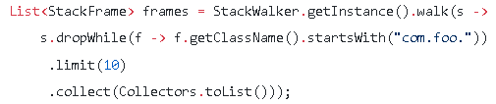
Stack-Walking API (cont.)
StackWalker it’s thread-safe, meaning that multiple threads can share a single StackWalker object to cross its own stack.
Example: we want to find the first 10 calling frames in the method, first skipping those frames whose declaring class is in package com.foo

Slide 31
HTML 5 Javadoc
Javadoc is the tool that can generate documentation for API in HTML format.
In previous version of JDK, it’s HTML 4.01 – an old standard.
JDK 9 Javadoc now supports to generate HTML5 markup, improves search capability and Doclint.

Slide 32
HTML 5 Javadoc (cont.)
In JDK 9 which supports HTML5, we just need to add -html5 parameter.
-Xdoclint enables recommended checks for issues in Javadoc comments: bad references, lack of accessibility, missing comments, syntax error and missing HTML tags.
By default, -Xdoclint is enabled. We can disable it by -Xdoclint:none
Example: javadoc -sourcepath "Java9HTML5Javadoc\src" example.html5doc -d home\html -html5

Slide 33
Unified JVM Logging
Java 9 provides a common logging system for JVM components with extremely detailed level.
We have a new command-line option -Xlog for all logging followed settings.
Logging levels: error, warning, info, debug, trace and develop.
Output supports 3 types: stdout, stderr, or a text file.
Messages can be “decorated” with: time, uptime, pid, tid, level, tags, etc.

Slide 34
Unified JVM Logging (cont.)
-Xlog:disable turns off all logging and clears all configuration of the logging framework.
Syntax for configuring the logging: -Xlog:tag[*][=level][:output:decoration:output-option],tag.
Default settings
. tag-set: all.
. level: info
. output: stdout
. decorators: uptime, level, tags

Slide 35
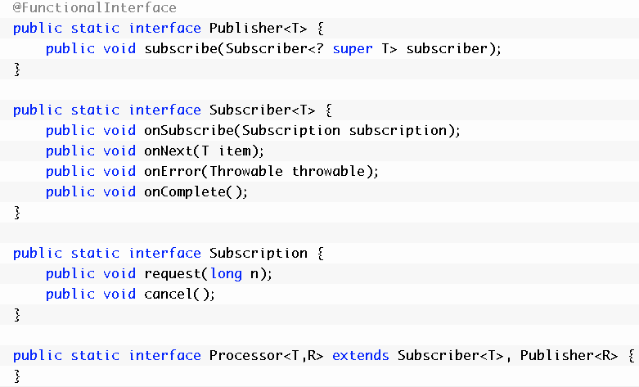
Reactive Streams
Java 9 introduces Reactive Streams under java.util.concurrent.Flow that supports an interoperable publish-subscribe framework.

Slide 36
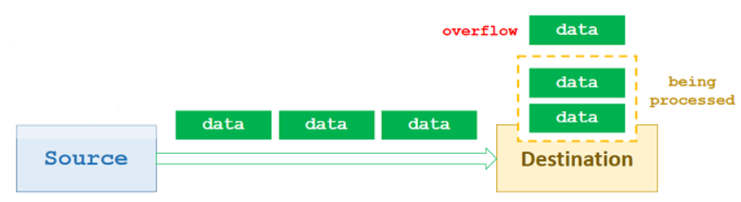
Reactive Streams (cont.)
Reactive Streams processes an asynchronous stream data across an asynchronous boundary (passing elements on to another thread or thread-pool), and receiving side (Destination) is not forced to buffer arbitrary amounts of data, then buffer overflow will not occur.

Slide 37
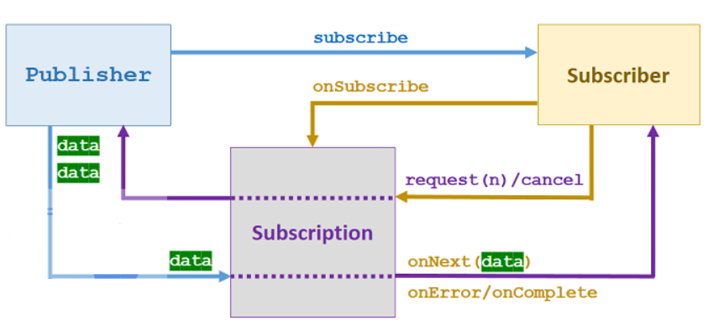
Reactive Streams (cont.)
Publish-Subscribe Pattern with Flow Control
It is a bi-directional transport:
signal for demand emitted from subscriber to publisher.
data flow emitted from publisher to subscriber.
If the subscriber emits a demand request, the publisher can push up to the number of request elements safety.
It helps to prevent wasting resources.

Slide 38
Reactive Streams (cont.)
Publisher uses its subscribe() method with Subscriber object as input parameter.
Publisher defines its own Subscription implementation and produces data elements for that Subscription.
When a Subscriber subscribes a Publisher, onSubscribe() method is invoked. Then Subscriber now can use Subscription to link to the Publisher by request(numberItems) or cancel() method.
Publisher uses Subscription to invoke Subscriber‘s methods:
onNext() if publishing items to the Subscriber asynchronously, normally using an Executor.
onComplete() when no more elements are available,
onError() if there is a failure.

Slide 39

Reactive Streams (cont.)
A Processor is a component that sits between the Publisher and Subscriber. It acts as:
a Subscriber when emitting a request signal to Publisher
a Publisher when pushing items to Subscriber.

Slide 40
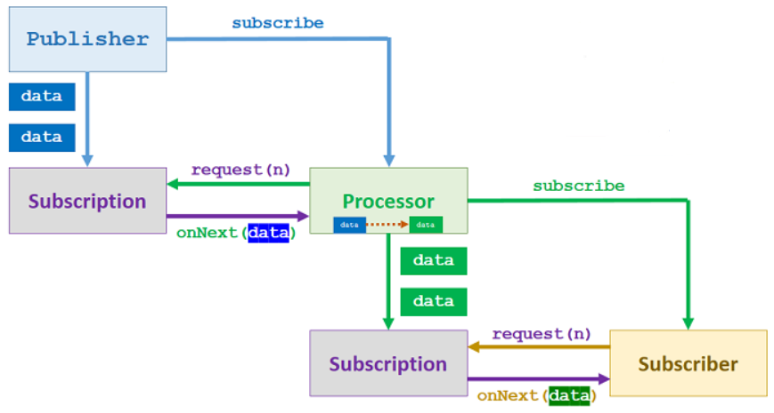
Reactive Streams (cont.)
Publisher define a Subscription to work with Processor.
Processor define its own Subscription to work with Subscriber.

Slide 41
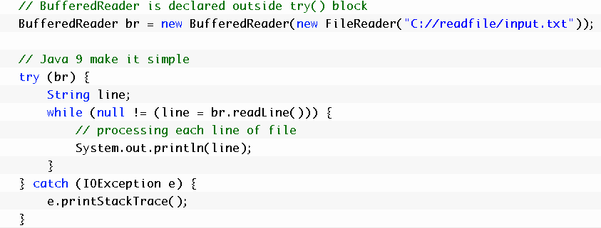
Other Improvements
try-with-resources Improvement
Java 7 introduces a new approach for closing resources by try-with-resources statement.
Java 9 try-with-resources makes an improved way of writing code.

Slide 42
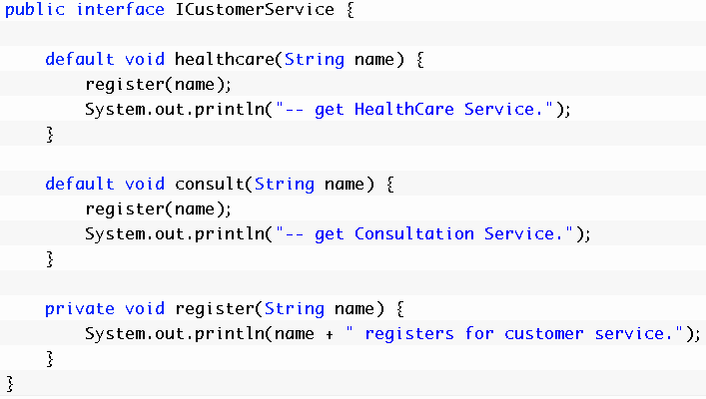
Other Improvements (cont.)
Private Interface Method
Java 8 provides 2 new features for Interface: default methods and static methods.
Java 9 adds new feature for interface: private method/private static method.

Slide 43
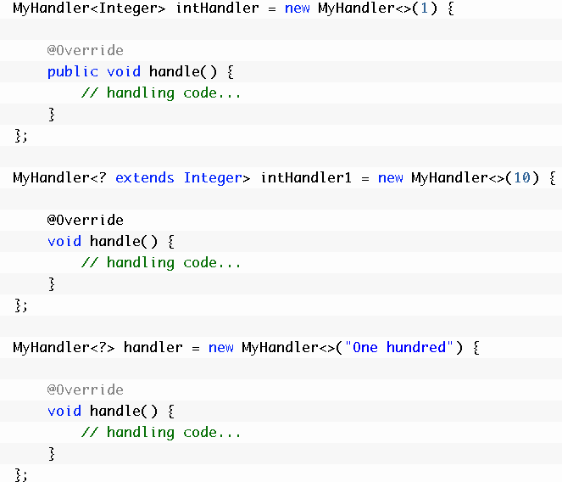
Other Improvements (cont.)
Diamond operator
Java 7 has a new feature called Diamond Operator which helps to make code more readable, but it is still limited with Anonymous Inner Classes.
Java 9 allows the Diamond Operator for Anonymous Inner Classes.

Slide 44
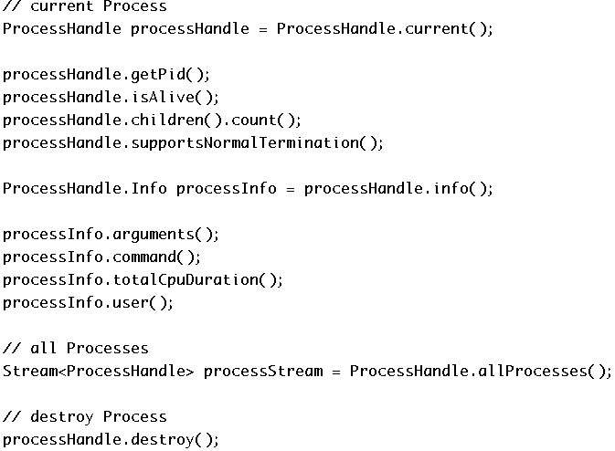
Other Improvements (cont.)
Process API
There are new ways of retrieving process information: all processes, current process, children processes and destroying process with Java 9 Process API.

Slide 45
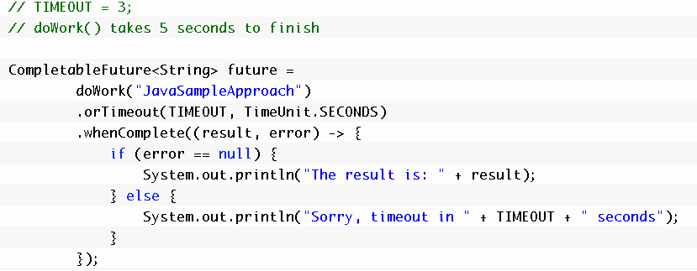
Other Improvements (cont.)
CompletableFuture API Enhancements
Java 8 provides CompletableFuture which can execute some code whenever its ready.
Java 9 improves CompletableFuture API that supports delay and timeout.

Slide 46

Other Improvements (cont.)
Factory Method for Collections: List, Set, Map
Java 9 provides new static factory methods for creating instances of collections and maps conveniently with small number of elements.
If we try to add/put more elements or null into them, we will get java.lang.UnsupportedOperationException or java.lang.NullPointerException.

Slide 47
Other Improvements (cont.)
Enhanced Deprecation
There are new added methods of Java 9 @Deprecated annotation: forRemoval() and since().
Example: @Deprecated(since ="1.5", forRemoval = true)

Slide 48
Other Improvements (cont.)
Unicode 8.0
Java 8 supported Unicode 6.2.
Java 9 now supports up to Unicode 8.0 standards with 10,555 characters, 29 scripts, and 42 blocks.

Slide 49
Other Improvements (cont.)
UTF-8 Properties Files
In previous releases, ISO-8859-1 encoding was used when loading property resource bundles.
Using ISO-8859-1 isn't a convenient way to represent non-Latin characters.
In Java 9, properties files are loaded in UTF-8 encoding.

Slide 50
Other Improvements (cont.)
Default Locale Data Change
In JDK 8 and previous releases, JRE is the default locale data.
JDK 9 sets CLDR (the locale data provided by the Unicode Common Locale Data Repository project) as highest priority by default.
This is how we select locale data source in the preferred order using java.locale.providers system property.
If a provider is failed to request locale data, the next provider will be processed.
If we don’t set the property, default behaviour is:
java.locale.providers=CLDR,COMPAT,SPI

Slide 51
Other Improvements (cont.)
JEP 241: Remove the jhat Tool
The jhat tool was an experimental and unsupported tool added in JDK 6.
It's out-of-date; superior heap visualizers and analyzers have been available for many years.

Slide 52
Other Improvements (cont.)
JEP 245: Validate JVM Command-Line Flag Arguments
Validates arguments to all numerical JVM command-line flags to avoid crashes and instead displays an appropriate error message if they are found to be invalid.
Range and optional constraint checks have been implemented for arguments which require a user-specified numerical value.

Slide 53
Other Improvements (cont.)
JEP 282: jlink: The Java Linker
Assembles and optimizes a set of modules and their dependencies into a custom runtime image as defined in JEP 220.
The jlink tool defines a plugin mechanism for transformation and optimization during the assembly process, and for the generation of alternative image formats.
It can create a custom runtime optimized for a single program.

Slide 54
Other Improvements (cont.)
JEP 219: Datagram Transport Layer Security (DTLS)
Enables Java Secure Socket Extension (JSSE) API and the SunJSSE security provider to support DTLS Version 1.0 and DTLS Version 1.2 protocols.

Slide 55
Other Improvements (cont.)
JEP 244: TLS Application-Layer Protocol Negotiation Extension
Enables the client and server in a TLS connection to negotiate the application protocol to be used.
With Application-Layer Protocol Negotiation (ALPN), the client sends the list of supported application protocols as part of the TLS ClientHello message.
The server chooses a protocol and returns the selected protocol as part of the TLS ServerHello message.
The application protocol negotiation can thus be accomplished within the TLS handshake, without adding network round-trips.

Slide 56
Other Improvements (cont.)
JEP 288: Disable SHA-1 Certificates
Improves the security configuration of the JDK by providing a more flexible mechanism to disable X.509 certificate chains with SHA-1 based signatures.
Disables SHA-1 in TLS Server certificate chains anchored by roots included by default in the JDK; local or enterprise CAs are not affected.
The jdk.certpath.disabledAlgorithms security property is enhanced with several new constraints that allow greater control over the types of certificates that can be disabled.

Slide 57
Other Improvements (cont.)
JEP 287: SHA-3 Hash Algorithms
Supports SHA-3 cryptographic hash functions as specified in NIST FIPS 202.
The following additional standard algorithms are supported by the java.security.MessageDigest API:SHA3-224, SHA3-256, SHA3-384, SHA3-512.
The following providers support SHA-3 algorithm enhancements:
SUN provider: SHA3-224, SHA3-256, SHA3-384, and SHA3-512
OracleUcrypto provider: SHA-3 digests supported by Solaris 12.0

Slide 58
Other Improvements (cont.)
JEP 289: Deprecate the Applet API
Deprecates the Applet API, which is becoming less useful as web browser vendors remove support for Java browser plug-ins.
While still available in JDK 9, the Applet class will be considered for removal in a future release.
Consider rewriting applets as Java Web Start or self-contained applications.

Slide 59
Other Improvements (cont.)
JEP 248: Make G1 the Default Garbage Collector
Makes G1 the default garbage collector on 32- and 64-bit server configurations.
Using a low-pause collector such as G1 provides a better overall experience, for most users, than a throughput-oriented collector such as the Parallel GC, which was previously the default.

Slide 60

Bibliography
http://en.wikipedia.org/wiki/Java_(programming_language)
https://en.wikipedia.org/wiki/JShell
https://labs.consol.de/development/2017/03/14/getting-started-with-java9-httpclient.html
http://blog.takipi.com/java-9-will-change-the-way-you-traverse-stack-traces/
http://javasampleapproach.com/java/java-9-module-system
http://javasampleapproach.com/java-9-tutorial
Deitel Developer Series - Java 9 for programmers

